Slide 1
Unit 8
Exercise 2
Activity 5

Slide 2
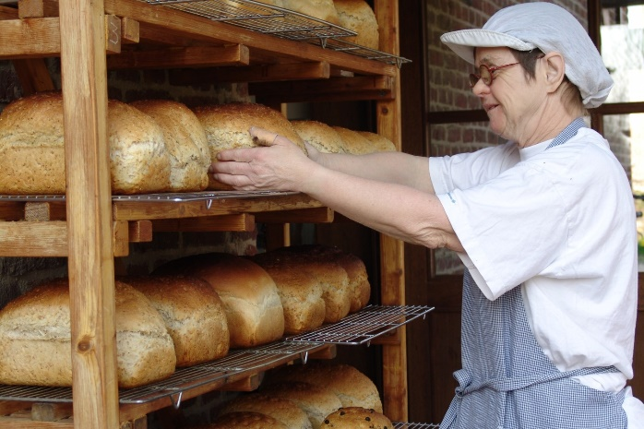
Maria always worked at the daycentre’s bakery.
The reason why she worked there was to feel competent.
When Maria was 60 years old she said:
“Now I stop working, like my brother did when he was 60.”
With the help of her brother and her support worker, Maria was able to try out some community activities.
Few months later, Maria was working at the cafe of an elderly home, were she was helping out behind the bar few hours a week as a volunteer.
But very soon, Maria was bored. She wanted to do things outside of the group home.
One of her dreams was to work in a cafe.
After retirement, Maria did some chores at the group-home where she lived. She did the ironing and always set the table.

Slide 3
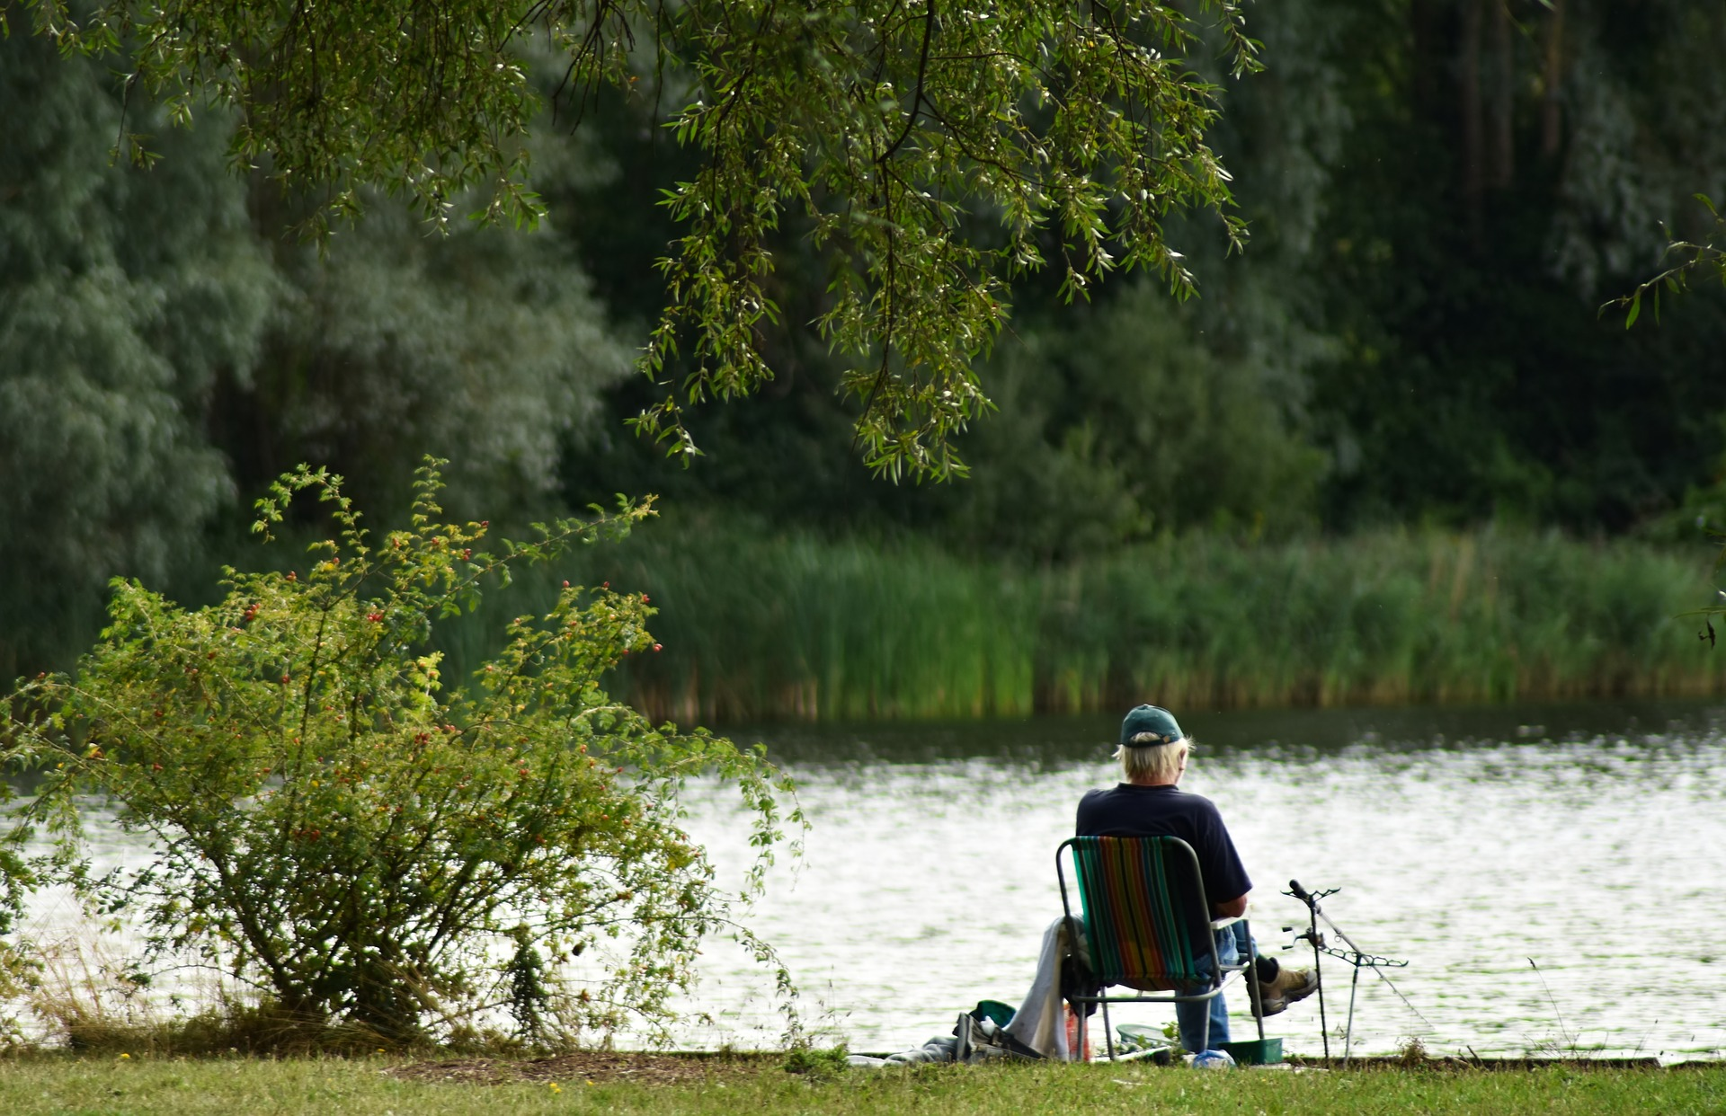
Filip worked as a painter for more than 20 years.
He worked mainly to be able to pay the bills and the rent.
When Filip was 60 he decided to completely retire from his payed job.
He was not interested in finding a voluntary work. Instead he goes back to school, where he learns to use the internet.
When Filip was 45 years old, he became very sick and had to cut down on work.
Instead of 5 days, he would work only 3 days a week.
Filip is happy with his new found freedom, although it wasn’t always easy as he now had less money from his retirement fund. He learned how to manage the money and lives a happy but sober life.
During the days off work, Filip chilled at home and took up fishing, one of his earlier hobbies from when he was still a kid. Later he even joint a fishing club.

Slide 4
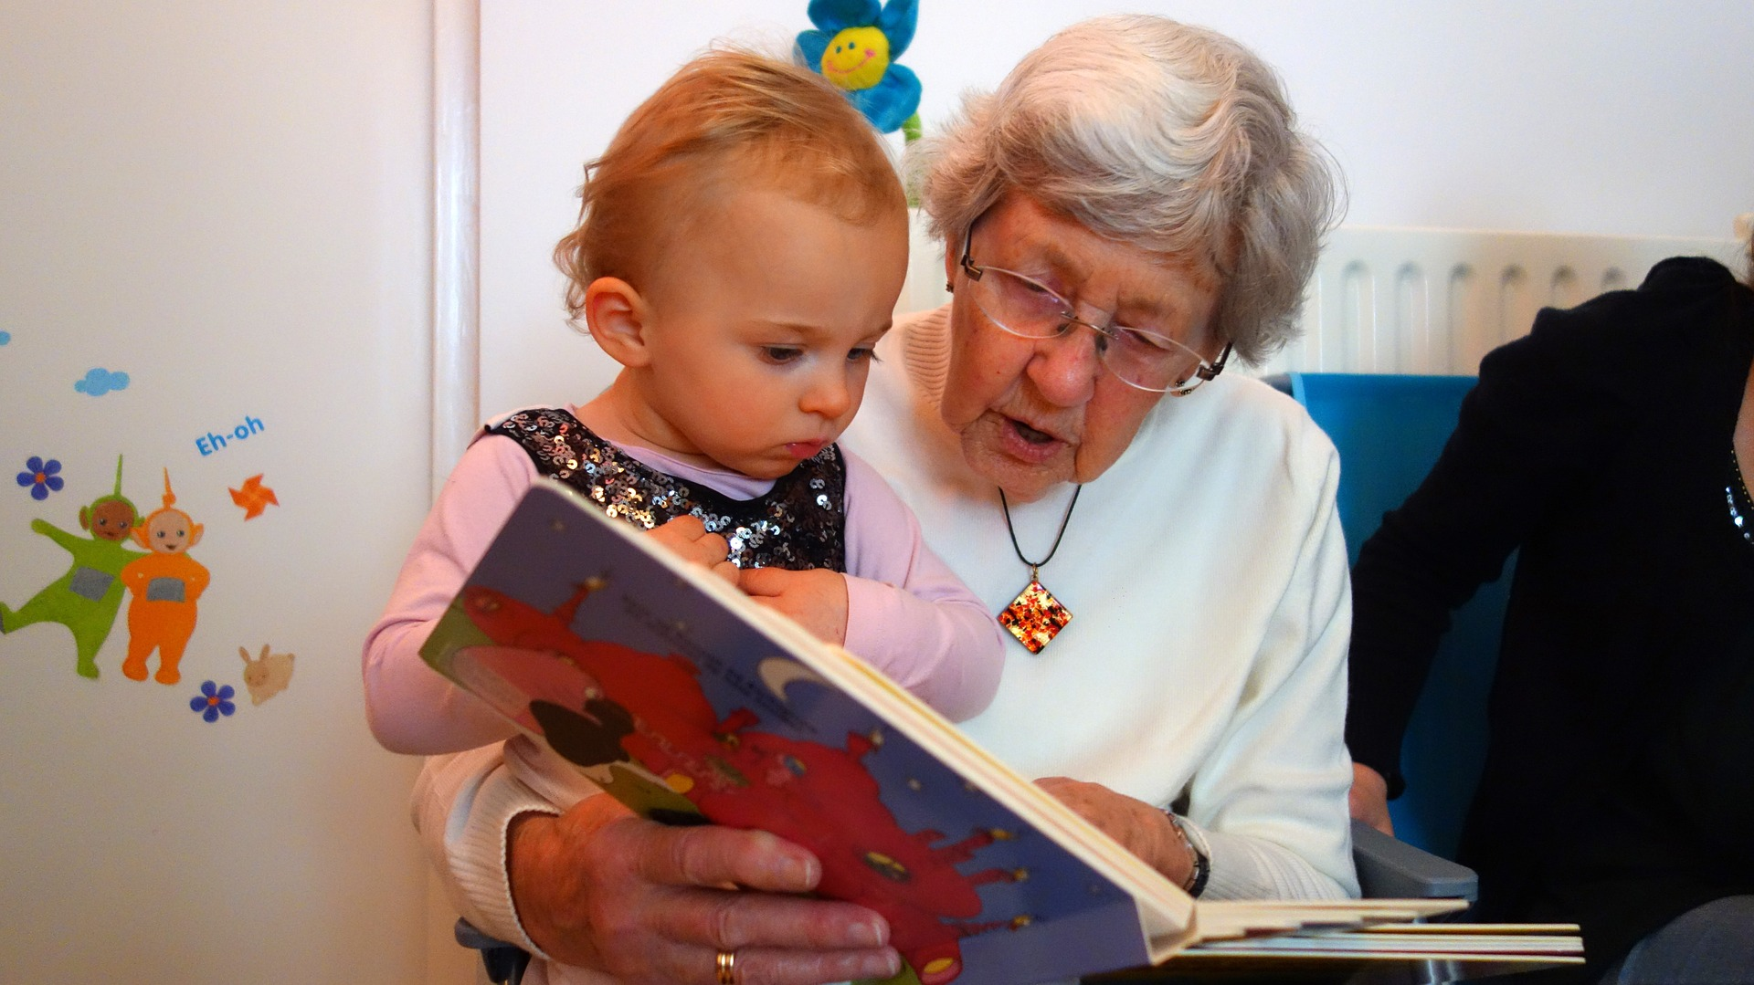
Anna worked 12 years for a cleaning company which is run by people with a learning disability.
She worked there so she could meet other people.
Anna is now a volunteer in two kinder-gardens were one’s a week, she reads short stories to the children.
When Anna became 55 years, she started to have a hard time keeping up with her tasks at work.
Anna’s brother tells that Anna always liked playing with small children.
Anna’s friend remarks that Anna also likes to read.
Anna’s support worker says she will look for such an activity that involved children.
Anna wants to do something completely new but she doesn’t know what.
Anna, her brother, her best friend and her support worker talk together about all the thing Anna likes to do.

Slide 5
Chris eventually decides to move into a group home. During the week he does the shopping for the group home, and helps with the cooking.
On Sunday morning he is a volunteer at the canteen of the local football club.
Once a week, when he feels up for it, Chris also does voluntary work at the animal shelter where he walks dogs.
For more than 40 years, Chris worked in a sheltered workplace where he had to prepare boxes.
He had no choice where he worked. “You have to do something” said his parents.
Chris is now 65 years old and was able to retire.
This makes him very happy but lately he starts to feel lonely at home.
Chris talked with his support worker about his feelings of loneliness.
His support worker arranged a meeting with Chris, his ex-employer and Chris’s friends from work, to talk about possible things Chris could do.

Slide 6
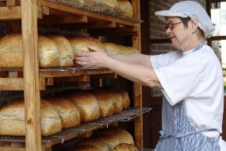
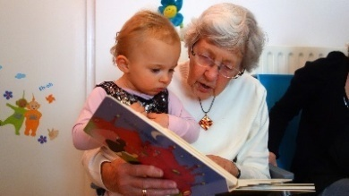
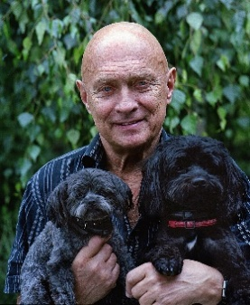
Reason for working: Find the match
Maria
Filip
Anna
Chris
For work satisfaction
For the money
To buy food
To feel competent
To meet people
To pay the bills and the rent
To pass time and not get bored
Have no choice

Slide 7
Correct answer
To feel competent
To pay the bills and the rent
To meet people
Have no choice
Maria
Filip
Anna
Chris

Slide 8
How old was Filip when he retired? Select the correct age.
o 60 years old
o 55 years old
o 45 years old
o 70 years old
60 years old

Slide 9
Why did Maria want to retire? Select the correct answer
she became very sick.
she wanted to, just like her brother at 60 years of age
she was 65 years old and was able to retire
she had a hard time keeping up with her tasks at work
She wanted to, just like her brother at 60 years of age

Slide 10
What did Filip do when he retired?
He worked in a bakery
He worked in a café
He joint a fishing club and learned how to use the internet
He did volunteer work at the animal shelter

Slide 11
What is Anna doing now that she has retired?
She is working at a cleaning company
She is a volunteer in a kinder-garden where she reads stories to children
She is volunteering at an elderly home
She is volunteer in kinder-garden where she reads stories to children

Slide 12
Who is volunteering in a football canteen?

