Slide 1



How do I wish to
(re-)connect with people that are important to me?
Exercise 2

Slide 2

Today we will talk about ways we can get into contact with others.

Slide 3
But first, we will continue with the story of Sam

Slide 4




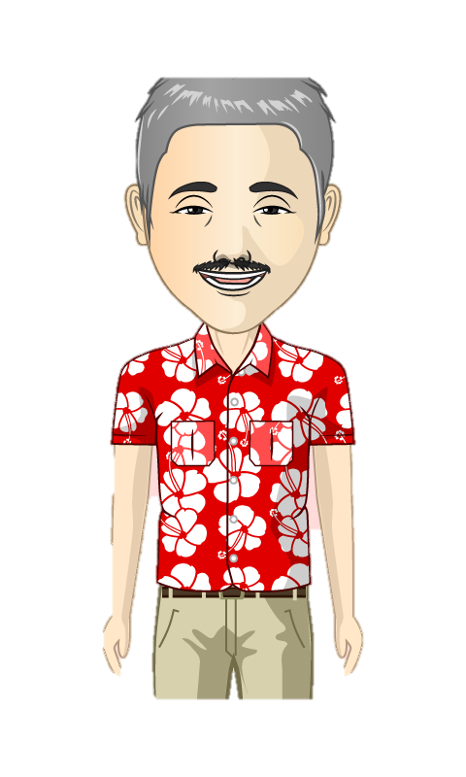








Do you remember who is who?

Slide 6

Sam’s support worker has found out that Jos is living in a group home, one hour away from where Sam lives.
She asks Sam to think about how he will be able to see his friend every day?

Slide 7
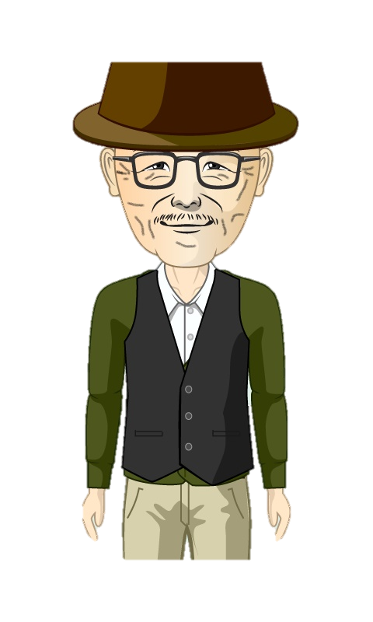
Sam realizes that he won’t be able to visit Jos every day because Jos lives to far away and he himself has difficulties moving around.

Slide 8

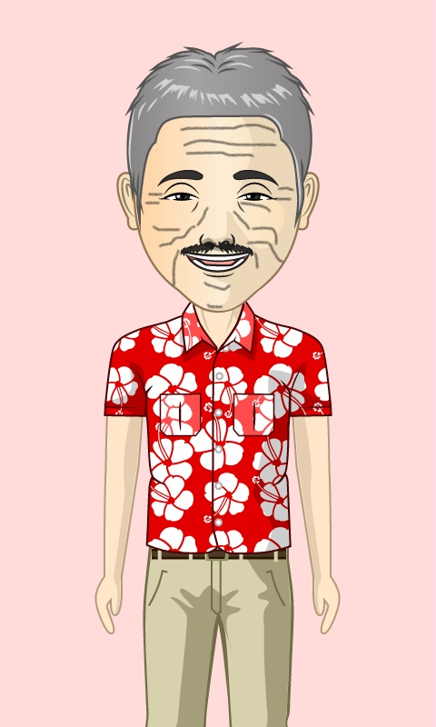
Jos is able to take a bus to visit Sam.
They decide that Jos would visit Sam at the retirement home every other week.

Slide 9

The support worker also proposes Sam to learn how to use WhatsApp.
This way he can text or even see Jos with face- time every day.

Slide 10
Sam is happy with the idea. Maybe he can use it to contact his brother Tony and Tessa as well? However, he hasn’t seen them for more than 25 years? Maybe they are still angry with him?

Slide 11

The support worker asks Sam what he would like to say to his brother if he were to see him again.
Maybe he can make a video with his smartphone and send it to Tony and Tessa?

Slide 12

Sam decided it would be best to write a letter. He asks his support worker to help him with it. He will send the letter using email on his notebook.

Slide 13
The support worker than asks Sam how he wishes to get into contact with his neighbours. They appear to have moved away as well.
.

Slide 14

Sam has heard how people found each other through social media, by using Facebook. Maybe he could learn how to use Facebook as well?

Slide 15
Exercise 1
Questions

Slide 16
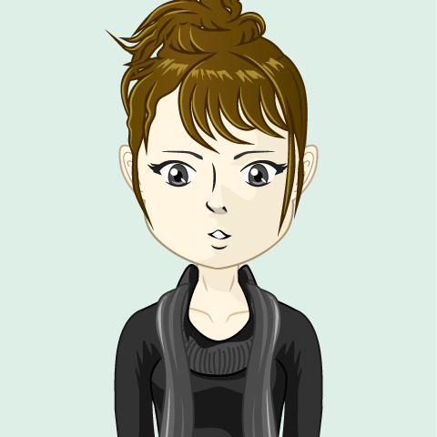


Is Sam able to see Jos every day? or
Explain your answer
Notes:
Sam was not able to see Jos physically every day but he could see him by using face time.

Slide 17
Did Sam know how to contact his brother? or
Explain your answer

Slide 18
Can Sam contact people without knowing their address or phone number? or
Explain your answer

