Slide 1



Who is important in my life?
EXERCISE 1

Slide 2
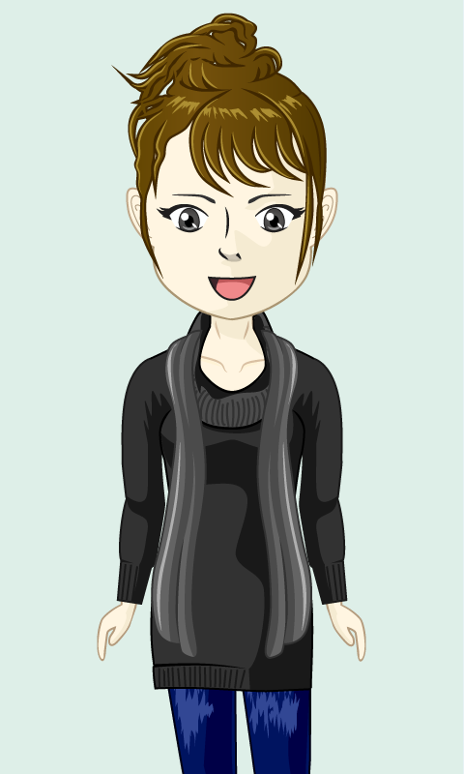
Hallo! My name is Ella.
Today we will do exercises to find out who has been important to you throughout your life.

Slide 3
But first, I would like to tell you the life story of Sam

Slide 4
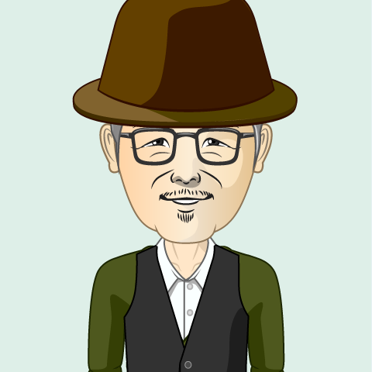





This is Sam.
He is 67 years old.

Slide 5
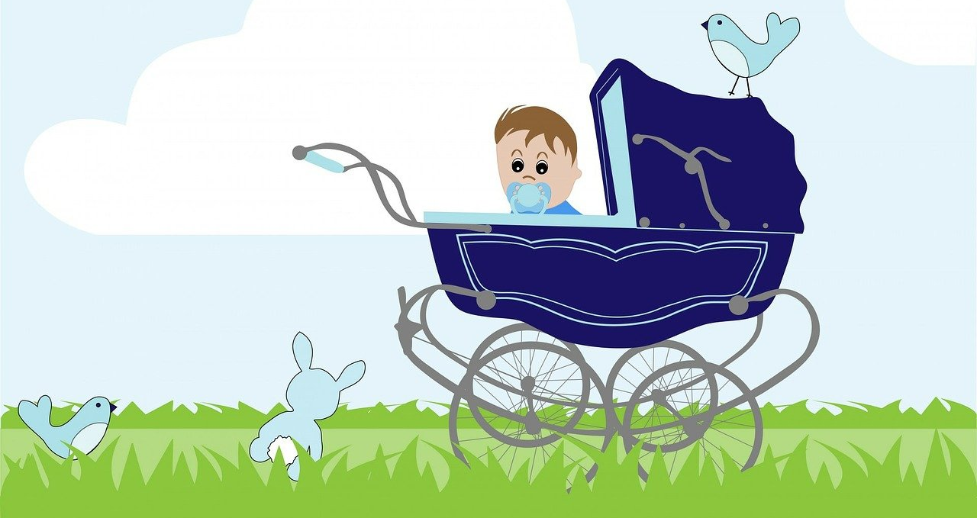
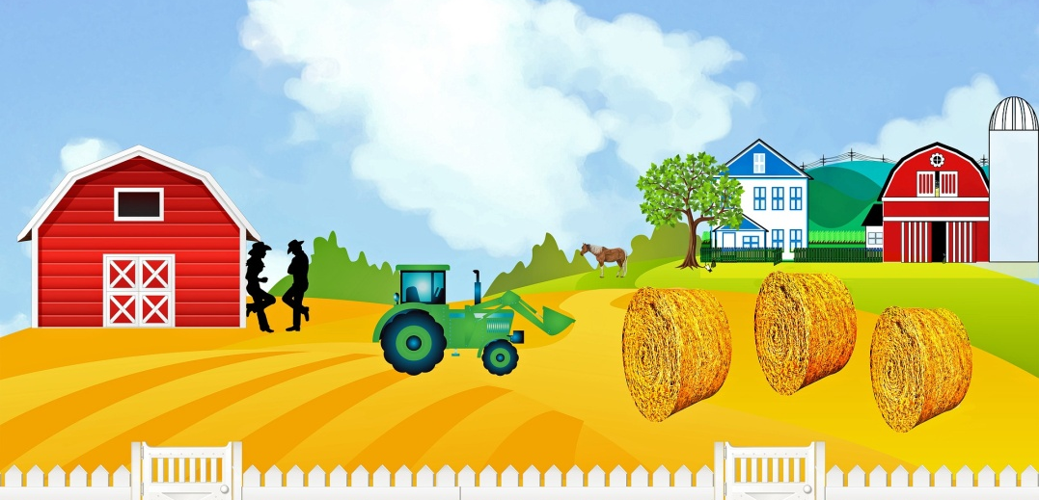

Sam was born in 1954 and he lived on a farm with his parents and his brother Tony until he was 30 years old.

Slide 6

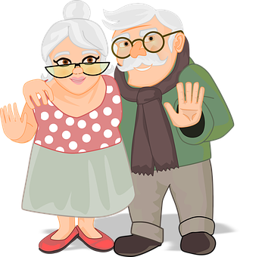
When Sam was 30 years old, his parents died.

Slide 7
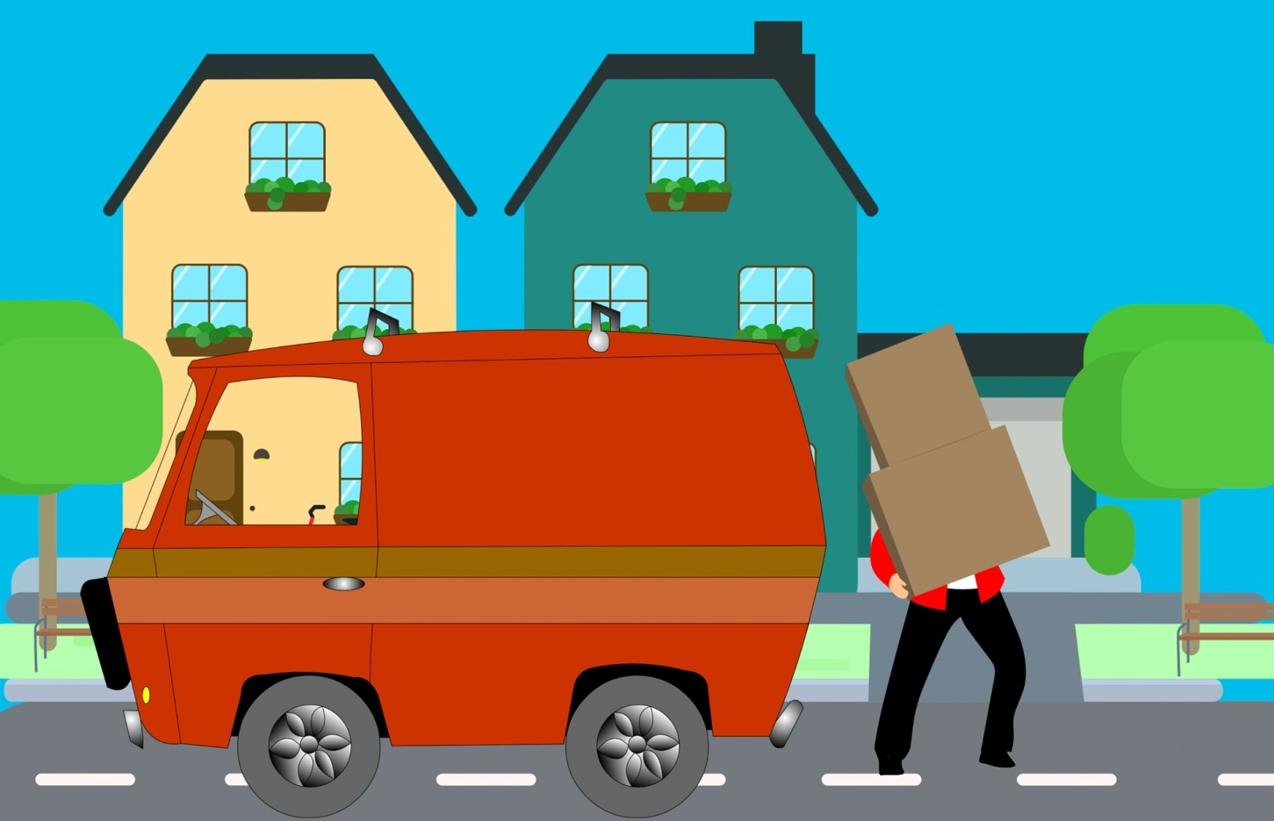


Sam could not stay at the farm alone and had to go live with his brother Tony and his wife Tessa.

Slide 8
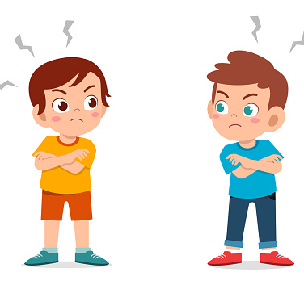
One day, Sam had a big fight with his brother Tony

Slide 9

Sam decided to move away. He went to life in a group home. After moving to the group home, Sam has lost all contact with his brother Tony and his sister-in-law Tessa.

Slide 10


At the group home he met Sophia who later became his wife.
In this group home he met Sophie.
He married her two years later.

Slide 11

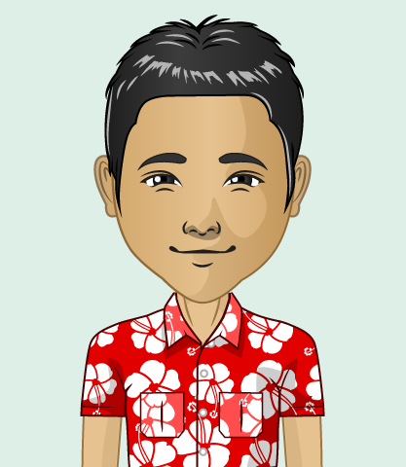
He also met Jos,
who became his best friend

Slide 12



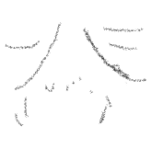




When Sam was 63 years old, his wife died

Slide 13
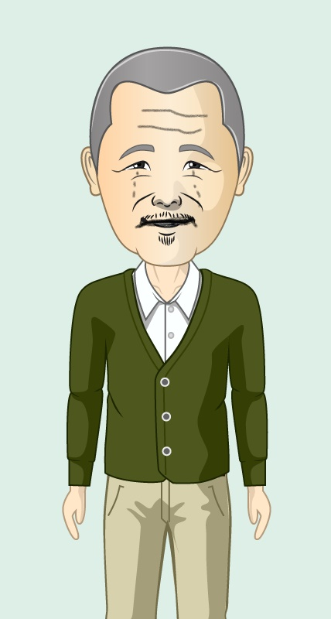
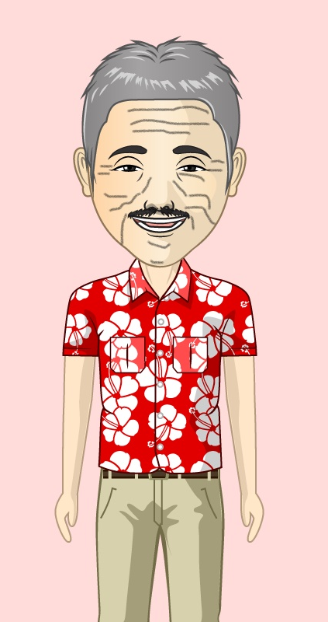
Sam was unhappy at the group home. He missed his wife.
He also missed his best friend Jos who had moved to another city.

Slide 14

When Sam became older, he needed much more support.

Slide 15

Sam needed to move to a retirement home

Slide 16
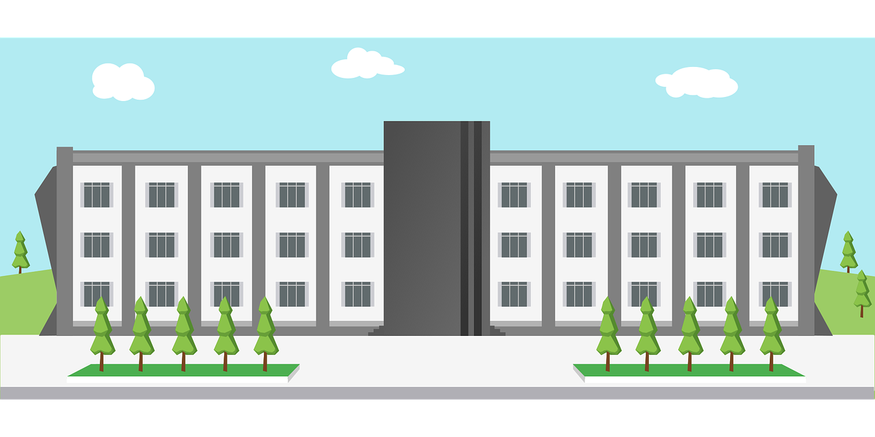

Hi Sam
At the retirement home, he meets his new care worker

Slide 17
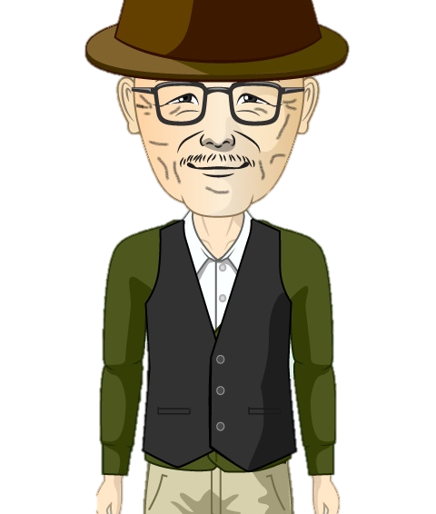
Sam is happy at the retirement home.
But sometimes he feels lonely.

Slide 18
His care worker asks him to talk about his life and about all the people he has met in his life.

Slide 19


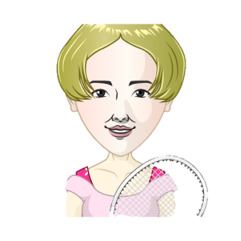
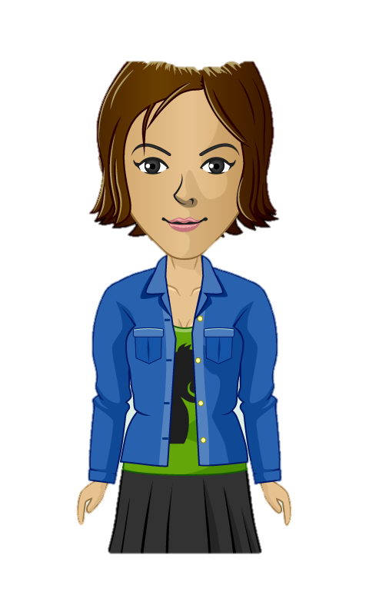
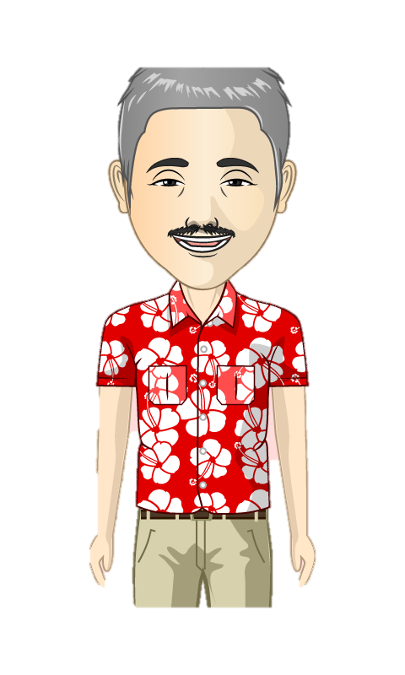
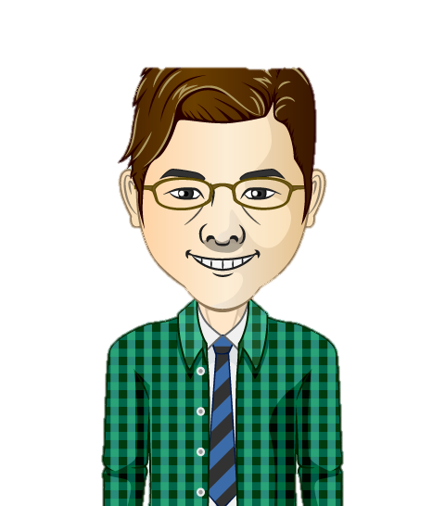
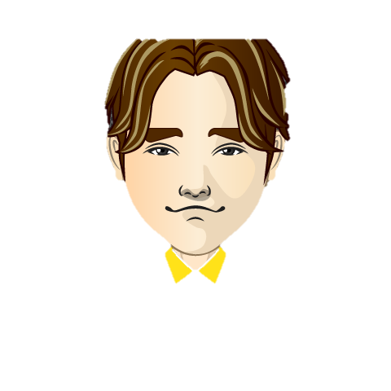
Together they make a collage of important persons Sam has lost contact with during his life.
His neighbours from the farm
His sister in law Tessa
His friend Jos
His support worker from the group home
His brother Tony

Slide 20
His neighbours from the farm
His sister-in-law Tessa
His friend Jos
His support worker from the group home
His brother Tony

Slide 21
Sam would like to reconnect with all of them, although he thinks his brother is still angry at him.

Slide 22
Activity 1
QUIZ

Slide 23
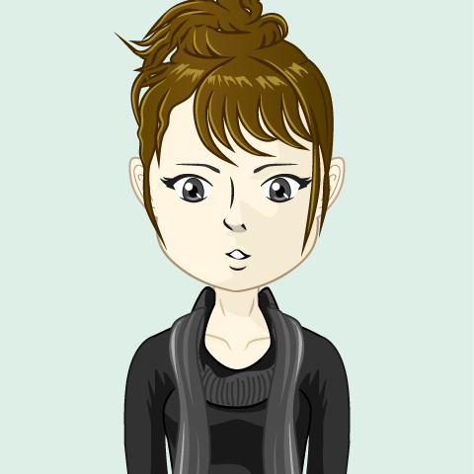
During his life, how many times had Sam to move to another place?

Slide 24
Select the correct answer
3 times
1 time
2 times
3 times
4 times

Slide 25
Why did Sam lose contact with his best friend Jos?

Slide 26
Jos moved to another city
Sam himself had moved away
Jos died
Jos had a big fight with his brother and lost all contact

Slide 27
Why did Sam lose contact with his brother Tony?

Slide 28
His brother had moved to another city
Sam had a fight with ‘Tessa’, his brother’s wife
His brother died
Sam had a fight with his brother and moved to a group home

Slide 29
Why did Sam move to a retirement home?

Slide 30
To be closer to his best friend Jos
He needed more support
His support worker had left the group home
To be with his wife Sophie

